Slide 1

Introduction to JavaScript
Basic Syntax, Conditions and Loops
SoftUni Team
Technical Trainers
Software University
https://softuni.bg

Slide 2
Table of Contents
Introduction
JavaScript Syntax
Conditional Statements
Logical Operators
Loops
Debugging and Troubleshooting

Slide 3
Have a Question?
sli.do
#fund-js

Slide 4
JavaScript Overview
Definition, Execution, IDE Setup

Slide 5
What is JavaScript?
JavaScript (JS) is a high-level programming language
One of the core technologies of the World Wide Web
Enables interactive web pages and applications
Can be executed on the server and on the client
Features:
C-like syntax (curly-brackets, identifiers, operator)
Multi-paradigm (imperative, functional, OOP)
Dynamic typing

Slide 6


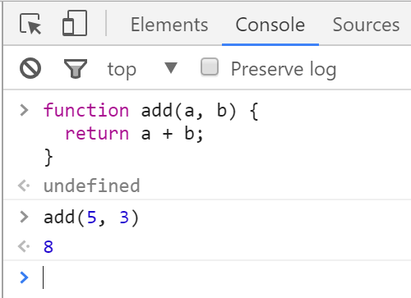
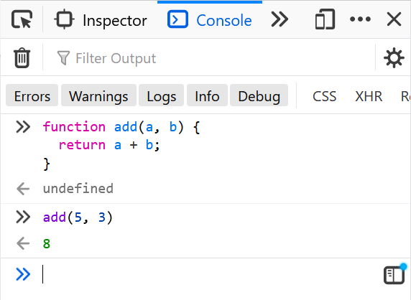
Web Browser Support
Developer Console: [F12]
The code shown in the example can be executed directly in the browser

Slide 7
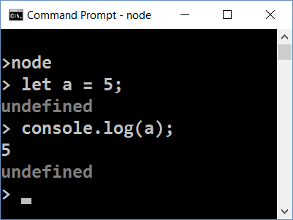
Node.js
What is Node.js?
Server-side JavaScript runtime
Chrome V8 JavaScript engine
NPM package manager
Install node packages

Slide 8
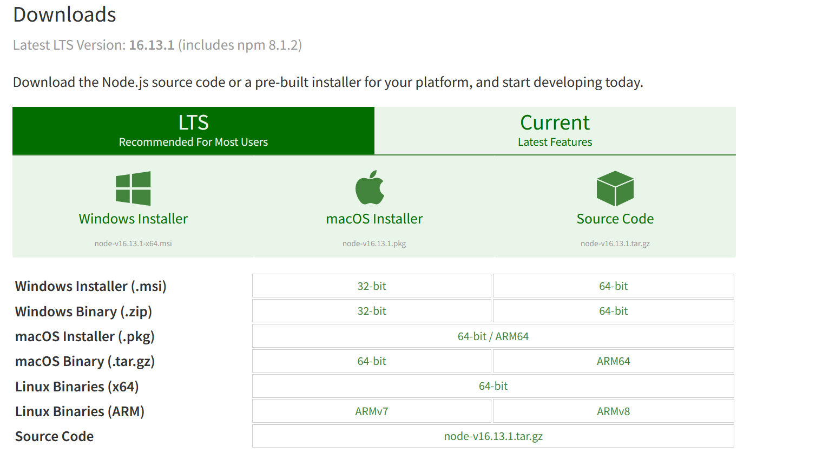
Install the Latest Node.js

Slide 9
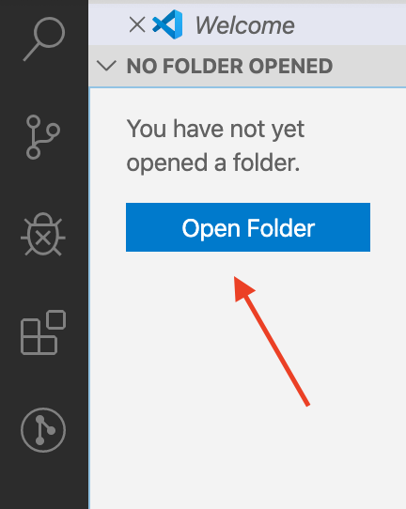
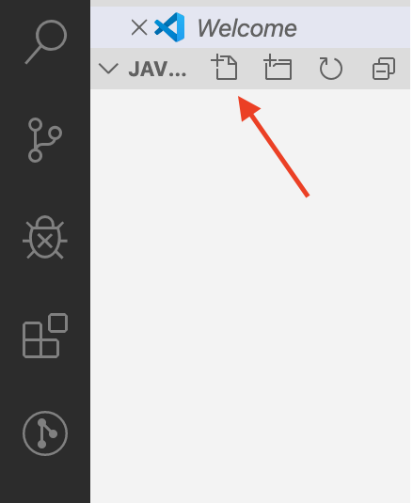
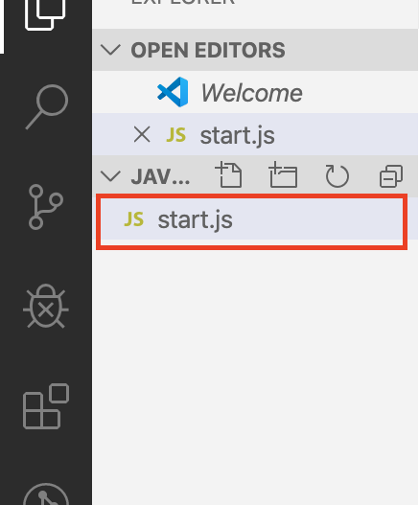
Using Visual Studio Code
Visual Studio Code is powerful text editor for JavaScript and other projects
In order to create your first project:

Slide 10
JavaScript Syntax
Functions, Operators, Input and Output

Slide 11
JavaScript Syntax
C-like syntax (curly-brackets, identifiers, operator)
Defining and Initializing variables:
Conditional statement:
Variable name
Declare a variable with let
let a = 5;
let b = 10;
Variable value
if (b > a) {
console.log(b);
}
Body of the conditional statement

Slide 12
Functions and Input Parameters
In order to solve different problems, we are going to use functions and the input will come as parameters
A function is similar to a procedure, that executes when called
declaration
parameters
function solve (num1, num2) { //some logic } solve(2, 3);
calling the function

Slide 13
Printing to the Console
We use the console.log() method to print to console:
Text can be composed easier using interpolated strings:
To format a number, use the toFixed() method (converts to string):
function solve (name, grade) {
console.log('The name is: ' + name + ', grade: ' + grade); } solve('Peter', 3.555);
//The name is: Peter, grade: 3.555
console.log(`The name is: ${name}, grade: ${grade}`);
Number of decimal places
grade.toFixed(2); //The name is: Petar, grade: 3.56

Slide 14
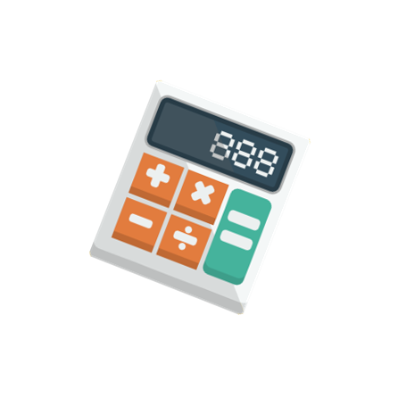
Problem: Multiply Number by Two
Write a function that receives a number and prints as a result that number multiplied by two
Input
Output
2
4
function solve (num) {
console.log(num * 2);
}
solve(2);

Slide 15
Comparison Operators
?
>
a
b
=
<

Slide 16
Comparison Operators
Operator | Notation in JS
Equal value Equal value and type | == ===
Not equal value Not equal value/type | != !==
Greater than | >
Greater than or Equal | >=
Less than | <
Less than or Equal | <=

Slide 17

Comparison Operators
Values can be compared:
let a = 5;
let b = 10;
console.log(a < b); // true
console.log(a > 0); // true
console.log(a > 100); // false
console.log(a < a); // false
console.log(a <= 5); // true
console.log(b == 2 * a); // true
console.log("2" === 2); // false

Slide 18
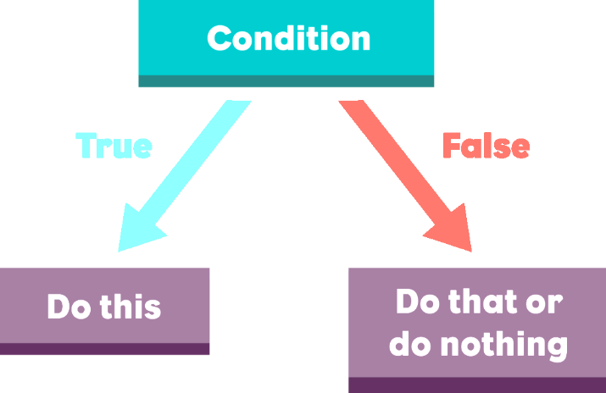
Conditional Statements
Implementing Control-Flow Logic

Slide 19
What is a Conditional Statement?
The if-else statement:
Do action depending on condition
You can chain conditions
let a = 5;
if (a >= 5) {
console.log(a);
}
If the condition is met, the code will execute
else {
console.log('no');
}
Continue on the next condition, if the first is not met

Slide 20
Problem: Excellent Grade
Write a function that receives a single number and checks if the grade is excellent or not.
If it is, print "Excellent", otherwise print "Not excellent"
function solve(grade){
if (grade >= 5.50) {
//TODO
} else {
//TODO
}
}
Input
Output
5.50
Excellent
4.35
Not excellent

Slide 21
Chained Conditional Statements
The if / else - if / else… construct is a series of checks
If one condition is true, it does not proceed to verify the following conditions
let a = 5;
if (a > 10)
console.log("Bigger than 10");
else if (a < 10)
console.log("Less than 10");
else
console.log("Equal to 10");
Only "Less than 10" will be printed

Slide 22

Problem: Foreign Languages
By given country print the typical spoken language:
English -> England, USA
Spanish -> Spain, Argentina, Mexico
other -> unknown
USA
English
Germany
unknown

Slide 23
Solution: Foreign Languages
function solve(country){
if (country == 'England') {
console.log('English');
} else if (country == 'USA') {
console.log('English');
} else if (country == 'Spain') {
console.log('Spanish');
} else if (country == 'Argentina') {
console.log('Spanish');
} else if (country == 'Mexico') {
console.log('Spanish');
} else {
console.log('unknown')
}
}

Slide 24
The Switch-case Statement
Works as a series of if / else if / else if…
switch (...){
case ...: …:
// code
break;
case ...:
// code
break;
default:
// code
break;
}
The condition in the switch case is a value
List of conditions (values) for the inspection
Code to be executed if there is no match with any case

Slide 25
Problem: Month Printer
Write a program that takes an integer as a parameter and prints the corresponding month
If the number is more than 12 or less than 1 print "Error!"
function solve(month) {
switch (month) {
case 1: console.log("January"); break;
case 2: console.log("February"); break;
// TODO: Add the other cases
default: console.log("Error!"); break;
}
}
2
February
13
Error!

Slide 26
Logical Operators
Writing More Complex Conditions

Slide 27
Logical Operators
Logical operators give us the ability to write multiple conditions in one if statement
They return a boolean result (true or false)
Operator | Description | Example
! | NOT | !false -> true
&& | AND | true && false -> false
|| | OR | true || false -> true

Slide 28
Logical Operators: Examples
Logical "AND"
Checks the fulfillment of several conditions simultaneously
Logical "OR"
Checks that at least one of several conditions is met
let a = 3;
let b = -2;
console.log(a > 0 && b > 0); // expected output: false
let a = 3;
let b = -2;
console.log(a > 0 || b > 0); // expected output: true

Slide 29
Logical Operators: Examples (2)
Logical "NOT"
Checks if a condition is not met
let a = 3;
let b = -2;
console.log(!(a > 0 || b > 0));
// expected output: false

Slide 30
Problem: Theatre Promotions
A theatre has the following ticket prices according to the age of the visitor and the type of day
If the given age does not fit one of the categories, print: "Error!"
Day / Age | 0 <= age <= 18 | 18 < age <= 64 | 64 < age <= 122
Weekday | 12$ | 18$ | 12$
Weekend | 15$ | 20$ | 15$
Holiday | 5$ | 12$ | 10$
Weekday
42
Holiday
-12
18$
Error!

Slide 31
Solution: Theatre Promotions
function solve(day, age) {
let price = 0;
if (day == 'Weekday') {
if ((age >= 0 && age <= 18) || (age > 64 && age <= 122)) {
price = 12;
}
// TODO: Add else statement for the other group
} else if (day == 'Weekend') {
if ((age >= 0 && age <= 18) || (age > 64 && age <= 122)) {
price = 15;
} else if (age > 18 && age <= 64) {
price = 20;
}
}
// Continued on next slide

Slide 32
Solution: Theatre Promotions (2)
else if (day == 'Holiday') {
if (age >= 0 && age <= 18) {
price = 5;
}
// TODO: Add the statements for the other cases
}
if (price != 0) {
console.log(price + '$');
} else {
console.log('Error!');
}
}

Slide 33

Loops
Code Block Repetition

Slide 34
What is a Loop?
The for loop:
Repeats until the condition is evaluated
The while loop:
Does the same, but has different structure
for (let i = 1; i <= 5; i++){
console.log(i)
}
Incrementation in the condition
let i = 1
while (i <= 5) {
console.log(i)
i++
}
Incrementation outside the condition

Slide 35

Problem: Divisible by 3
Print the numbers from 1 to 100, which are divisible by 3
The program should not receive input.
function solve() {
for (let i = 3; i <= 100; i += 3){
console.log(i);
}
}

Slide 36
Problem: Numbers from N to 1
Write a function that receives a number N and prints the all numbers from N to 1. Try using a while loop.
Input
Output
function solve(n) { while(/*TODO*/) { console.log(n); n--; } } solve(5);
5
5
4
3
2
1

Slide 37

Debugging the Code

Slide 38

Debugging the Code
The process of debugging application includes:
Spotting an error
Finding the lines of code that cause the error
Fixing the error in the code
Testing to check if the error is gone and no new errors are introduced
Iterative and continuous process

Slide 39
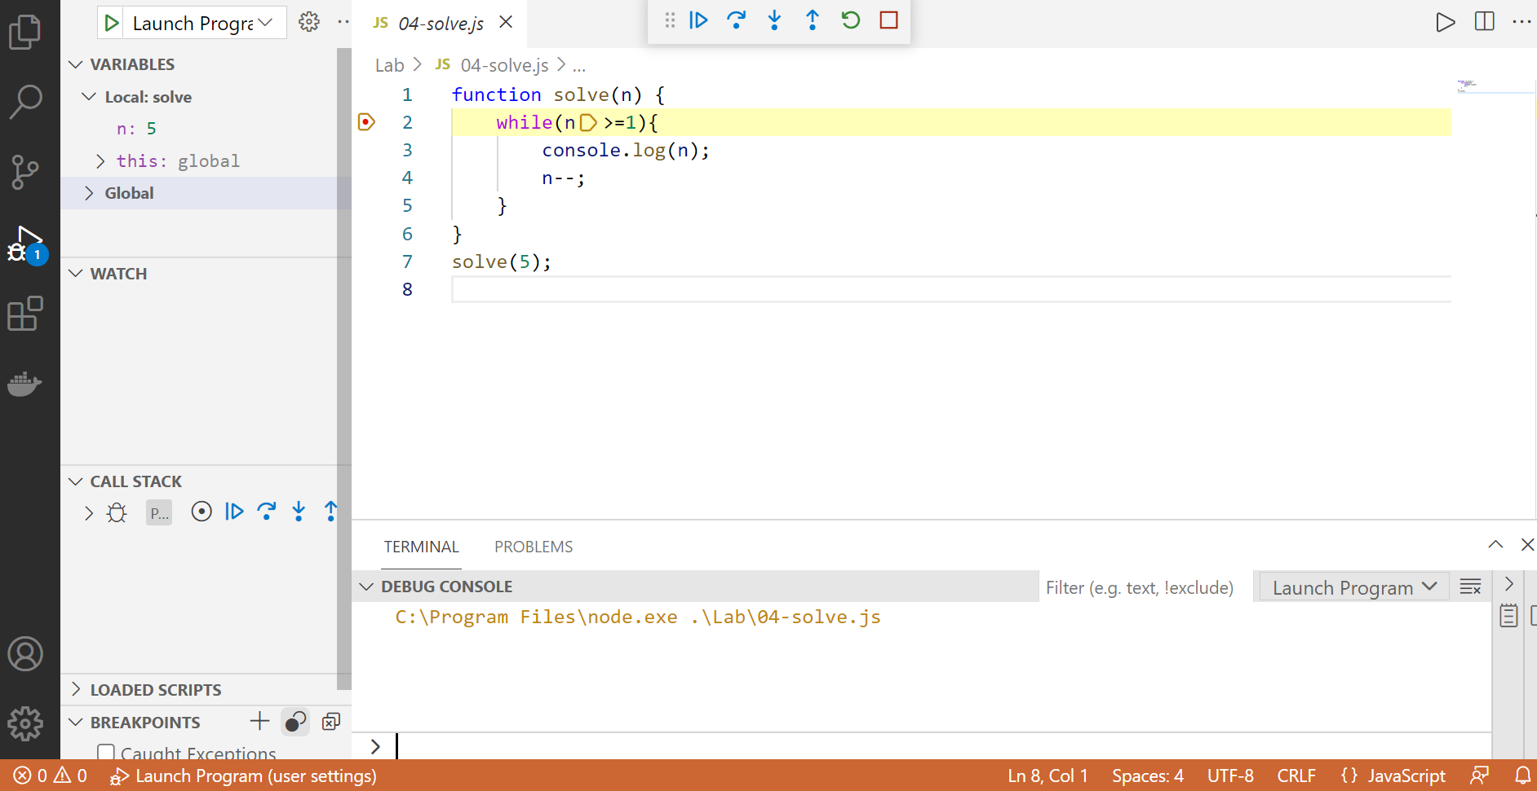
Debugging in Visual Studio Code
Visual Studio Code has a built-in debugger
It provides:
Breakpoints
Ability to trace the code execution
Ability to inspect variables at runtime

Slide 40
Using the Debugger in Visual Studio Code
Start without Debugger: [Ctrl+F5]
Start with Debugger: [F5]
Toggle a breakpoint: [F9]
Trace step by step: [F10]
Force step into: [F11]

Slide 41

Live Exercises

Slide 42

Summary
…
…
…
Declare variables with 'let'
Use if-else statements to check for conditions
Use loops to avoid repeating code
Use the debugger to check for mistakes in the code

Slide 43
Questions?
Notes:
43

Slide 44














SoftUni Diamond Partners

Slide 45

Educational Partners

Slide 46
Trainings @ Software University (SoftUni)
Software University – High-Quality Education, Profession and Job for Software Developers
softuni.bg
Software University Foundation
softuni.foundation
Software University @ Facebook
facebook.com/SoftwareUniversity
Software University Forums
forum.softuni.bg
Notes:
46

Slide 47

License
This course (slides, examples, demos, exercises, homework, documents, videos and other assets) is copyrighted content
Unauthorized copy, reproduction or use is illegal
© SoftUni – https://about.softuni.bg/
© Software University – https://softuni.bg
Notes:
47

